Slide 2
Welcome & Congratulations!
Bob Macina
Executive Vice President

Slide 3



Boot Camp Overview / Activities
Introduction + Ice Breaker
Problem Driver + Needle
Solution + Assumption
Action + Next Steps

Slide 4
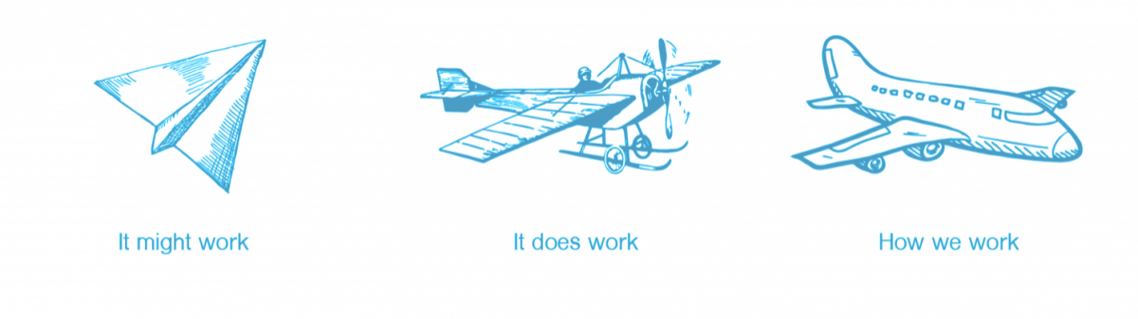
Inaugural 2019 CHCI- LGH Innovation Accelerator Program
Phase 1: “It might work”
November 2019-April 2020
EXPLORE
Phase 2: “It does work”
~ June 2020-April 2021
SCALE
Phase 3: “How we work”
~ June 2021
SUSTAIN
  Funding: up to $10,000
  Training: Workshops on rapidly validating solutions
  Advisors & Team Support: Project management & design
  Funding: up to $50,000
  Training: Workshops on bringing innovation to scale
  Advisors & Team Support: Project management & design
  Gap resources as needed: Funding, staff support, etc
Notes:
The Innovation Accelerator Program is designed to support staff from across Penn Medicine Lancaster General Health in their efforts to develop, test, and implement new approaches to improve health care delivery and patient outcomes. In your folders we’ve provided more detail around the funding, training, and advising. In addition to the folder, we have set up an online portal with these resources that will be available to all of you.

Slide 5
Phase 1 Timeline
October
November
December
January
February
March
April
Design Cycle 1
Design Cycle 2
Design Cycle 3
Platforms for Innovation workshop
Data Systems & Analysis workshop
Health Systems, Finance, and Defining ROI workshop
Storytelling for Impact workshop
Pitch Day
Boot Camp
Design Cycle Report Out
Design Cycle Report Out
Design Cycle Report Out
Weekly Team meetings / Bi-weekly mentor meetings

Slide 6
A Friendly Competition
Who can create the highest tower?

Slide 7
Rules
Your tower can stand only within blue box
Each team will have only 2 minutes to develop their strategy. During this time you are not allowed to touch your cups.
Each team will then have only 30 seconds to create their tower.
You do not have to use all of the cups, just create the highest stack.
Every team member must contribute.
Spectators cannot participate in building the stack.
Notes:
What did you learn from the cup stacking activity? The idea is to teach some of the methods and mindsets needed in going through the innovation process.

Slide 8
Innovation is a process of defining, designing, and delivering new value
Notes:
8:45am

Slide 9
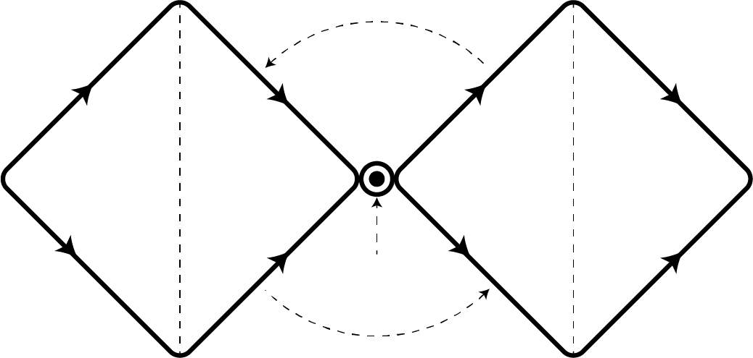
Innovation Framework
Problem Definition
Solution Definition
?
Discover
Define
Ideate
Validate
Measurable
Outcome /
Needle
Problem
Impact
Notes:
This is a framework and not a step-by-step process. Similar to how we structured the program within three design cycles and similar to the cup stacking game of doing it three times, we expect there will be starts and stops. But the goal is to be able to move as quickly as possible and open ourselves up to reframing the problem, generating ideas and testing those ideas.

Slide 10
Boot Camp Overview / Activities
Introduction + Ice Breaker
Needle + Problem Driver
Solution + Assumption
Action + Next Steps
Notes:
There are a series of methods we will utilize to help us start small, think big, move quickly, fail fast and ensure what we come up with is moving our needle and solving the problem for the biggest impact. We will walk you through a few of those methods in today’s bootcamp. Matt is going to start with some methods for helping us better understand our problem drivers and the needle we are trying to move.

Slide 11

Moving the Needle
Notes:
A key aspect of moving forward in a design project is clearly defining the needle you want to move. One way to think about this is, in a world where you wave a magic wand and your innovation works perfectly, what meaningful and measurable impact is made and for whom?
Having the correct target in mind is critical, because the solution you design will be completely different based on what you’re trying to accomplish. I’ll share a quick story to exemplify this. Then we can discuss a few methods we use at the center to help teams figure out what the needle to move should be.

Slide 12

What’s Good About That?
Notes:
At the center, we have two approaches that help us get to the right metric. The first is about working upwards towards big, impactful metric we hope to move. It’s pretty simple – we ask people who say they want to fix something the question “what’s good about that?” I’ll share a story that exemplify this.
In the 80’s, Hertz had pretty much invented the worst line wait of all time. Now, if we had taken a typical approach, meaning sticking with what’s observable (which was the line wait time), done Journey Mapping, or used CI techniques, we may have come to the conclusion that the problem was the slow line and that making it go faster in some way was the solution.
We could use a CI type approach to uncover inefficiencies like “redundant paper work” or “poor staffing allocation” etc.
The issue is that all of this assumes that a line is needed in the first place. But is it? In this case, Hertz used the approach of asking “what’s good about that?
In this example, people wanted a faster line.
Well, so what’ good about a faster line?
Well then people could get in their cars faster? What’s good about getting to the cars faster?
Well people could get to where they want to be faster?
Aha! So the real metric isn’t line speed, it’s getting people from the plane to where they want to be as quickly as possible. In this instance, there are lots of ways to do that which don’t involve a line at all.

Slide 13

Notes:
And thus Hertz Gold was born. This was a program that allowed members to skip the counter and the paperwork altogether! But it never would have been thought of if the metric was focused on line speed. Next is a healthcare example

Slide 14

How might we …
“increase access to incubators”
?
Problem
Notes:
Stanford Design school students were tasked with the problem of high rates of infant mortality after birth in third world countries. If you were to ask “experts” about what metric was important to move, they would have said, well, they need better access to incubators. We need to get more incubators, and closer to where patients are….
But what these students discovered, by going to these communities, was that it wasn’t necessarily incubators that they needed……. but what was good about incubators was that babies would get to the right temperature faster….

Slide 15

How might we …
“get newborns to the correct body temperature quickly?”
Measurable outcome
Notes:
By going to these communities, learning more about the problem and assumptions, & asking “what’s good about that” they got past the initial metric, which had a solution already baked in. Instead, they could now use that solution criteria to drive a better solution….

Slide 16
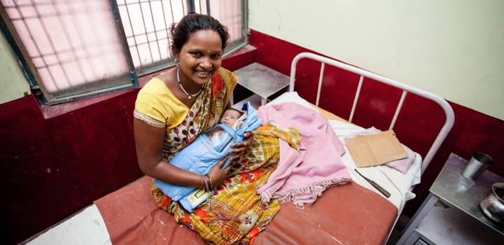
A better solution for a fraction of the price
Impact
Notes:
By the end of the semester, the students designed a prototype of a small sleep sack that was kept warm by inserted packets of hot water. Not only was this more cost efficient than incubators, but it also worked well with cultural norms that newborn babies not be separated from their mothers. Thus it also had a very high adoption rate.
The team went on to create a company and now supplies these around the world to help save the lives of premature and low-birth-weight newborns …. So how did they do it?

Slide 17

Innovation Framework
Problem Questions & Assumptions
What must you know about a problem in order to solve it?
Notes:
What I want to talk to you about now is how to make sure you identify what you need to know about a problem in order to solve it.
Often when we identify a problem our brain tries to make sense of it. And when we aren’t quite sure of the source, we make assumptions, filling in the blanks with sometimes erroneous information. It is just natural, we are problem solvers our job is to know the right answer. Not knowing it make us uncomfortable.

Slide 18

That weird sound in the attic is probably not a ghost …
Notes:
So, what I want to show you is how to make sure you don’t call ghostbusters (as cool as they might be) prematurely. Because that weird sound in the attic is probably not a ghost, that is just your assumption. And as uncomfortable as it might feel, you are going to have to walk up there and take a peek first.

Slide 19
What is a problem assumption?
A problem assumption is something that must be true
to lead to an effective solution.
Focus on the assumptions that are key to defining your problem and metric correctly.
Search for information that will help you learn about it, not just confirm it.
Notes:
Now what are problem assumptions? Problem assumptions are the things we think we know about a problem. If our assumptions are not true, the solution we design may not work well, or not at all. Key assumptions help us to define the problem and choose the right metric to measure success. Having identified key assumptions, we need to search for information that will help us learn more about them. Confirming our assumptions is not the goal, as it is just as important to prove ourselves wrong so we won’t go off in the wrong direction.

Slide 20
“Discover” the Problem Methods
Secondary Research
What is it: Information that others have gathered through primary research
Good for: Assessing easy, low-cost and quick knowledge
Notes:
There are several methods available to us that can be used to better understand the problem. Many times we start with secondary research, or “desk research,” where we search for and review research that has already been conducted by other investigators. We also utilize our own experiences and knowledge to fill in the information that we don’t quite know about the problem.

Slide 21
Premature infants don’t have access to Incubators
Hospital incubators are rare in Kathmandu
Expensive
Donated Incubators
Confusing to operate
Difficult to repair
Notes:
The team started out by doing secondary research and talking to family members. It became clear that Nepal had one of the highest rates of infant mortality in the world, so they narrowed their focus to the hospitals in Kathmandu.
If the team would have stopped here, they would have focused on designing a less expensive and easier to use incubator that is a hospital-based solution – so essentially designing a cheaper mousetrap.

Slide 22
“Discover” the Problem Methods
Secondary Research
What is it: Information that others have gathered through primary research
Good for: Assessing easy, low-cost and quick knowledge
2. Contextual Inquiry
What is it: Observation and interviewing in context
Good for: Build first-hand understanding of behaviors and experiences
Notes:
The second method I want to introduce to you is called contextual inquiry. Put simply, contextual inquiry is a combination of observation and interviewing. It means going out into the environment you're focused on, making observations, asking questions, and collecting detailed information about what you see, hear, and any insights you may have along the way.

Slide 23
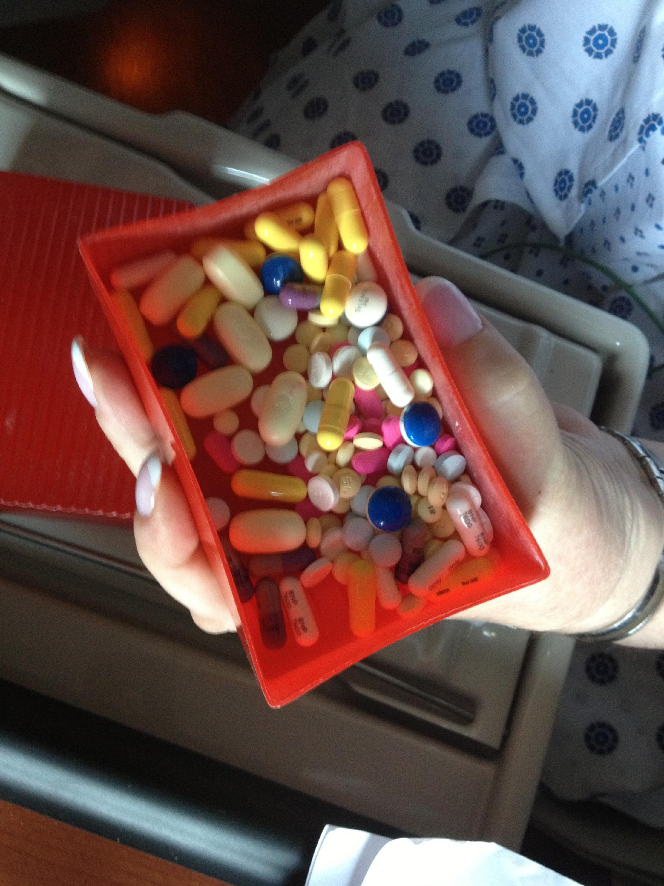
  Contextual Inquiry
  Observation and interviewing in context
“Show me”
Notes:
Matt from the Penn Center for Innovation visited patients recently discharged from the hospital trying to better understand the difficulties patients face with discharge instructions.
When Matt asked about her medications, she told him she had them organized. But when Matt politely asked her to show him, she pulled out this box with loose, unmarked pills inside.
The point here is simply to highlight that what people say they do and what they actually do are different things.
In the case of this patient, she probably wasn’t trying to be misleading. By all accounts, she was happy with this solution, even though it poses some obvious risks.
Words like ‘organized’ mean different things to different people. By going out and doing contextual inquiry, Matt was able to experience first-hand how things were actually happening in practice.

Slide 24
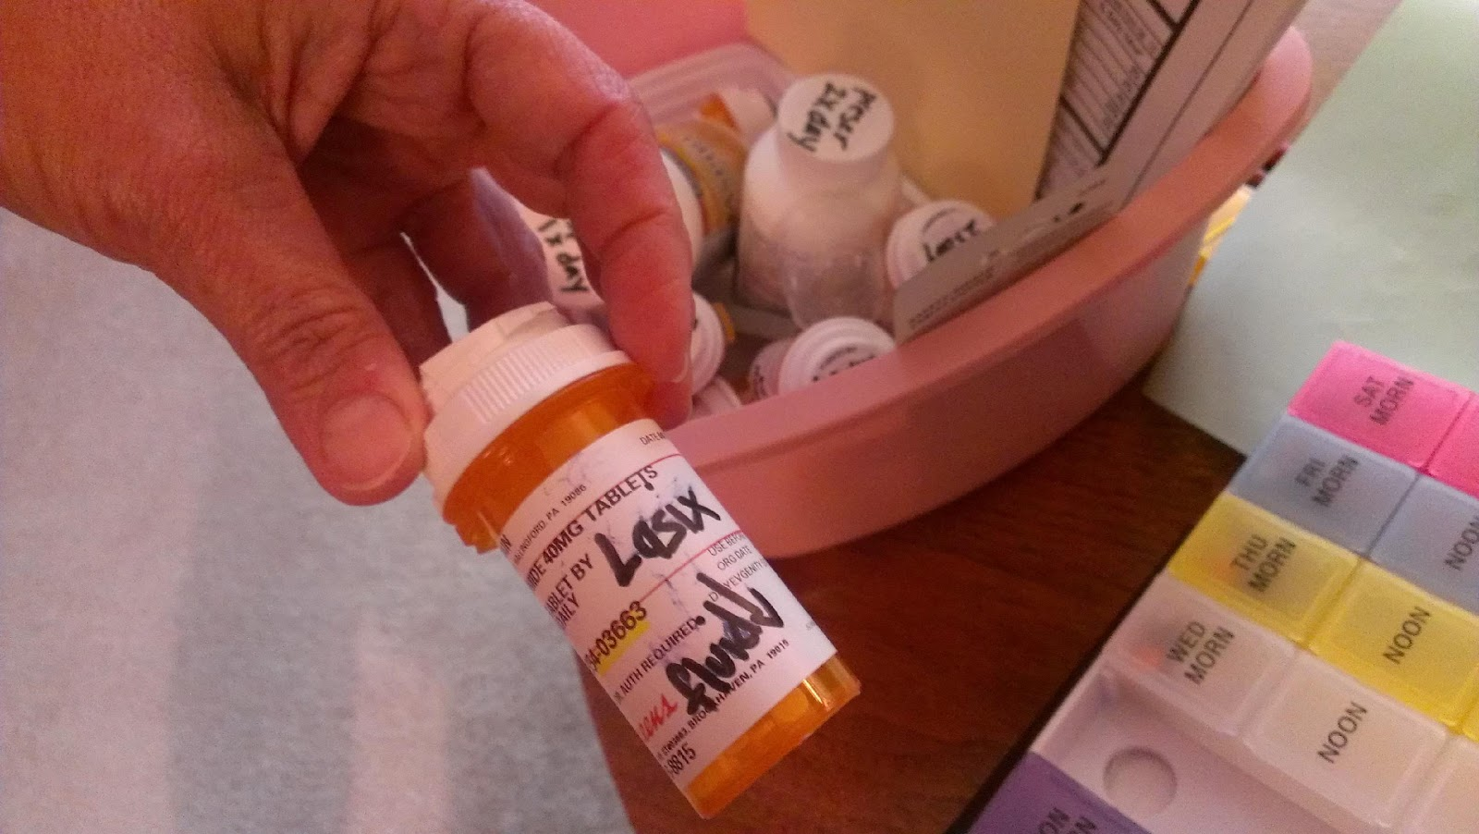
  Contextual Inquiry
  Observation and interviewing in context
Look for workarounds
Notes:
While visiting with a different patient who had congestive heart failure, Matt asked how she was keeping track of what she was supposed to do and when.
She showed him some of the tools she used, like the pillbox you see on the right. She had also gone back and written in Sharpie on each pill bottle what it was called and what it’s for. You can see Matt holding a bottle of oral diuretic, which she wrote was to reduce fluid.
By going out and immersing himself in the problem space, Matt discovered work-arounds patients were using to stay on top of their discharge instructions. These observations opened up new opportunities for solutions beyond just re-designing the existing discharge instructions.

Slide 25
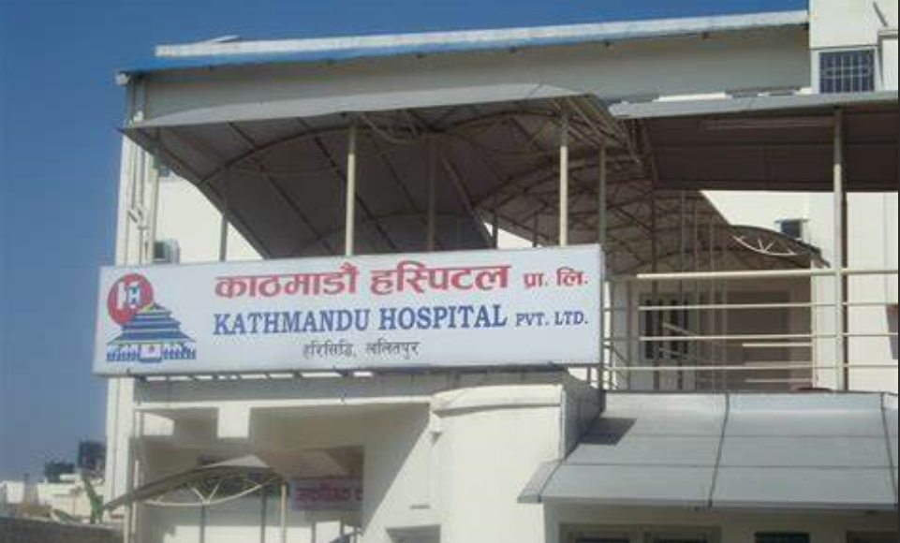
  Contextual Inquiry
  Observation and interviewing in context
Notes:
Returning to the infant mortality problem, the Stanford team initially spent several days observing and interviewing people in the neonatal unit of the Kathmandu hospital. After spending several days observing there, the team asked to be taken outside the city to see how premature infants were cared for in rural areas. Due to the rural mountainous terrain, the distance to the hospital and lack of transportation, the team learned that the overwhelming majority of Nepalese infants are born at home in these rural areas, not in the hospital.

Slide 26
Premature infants don’t have access to incubators
Incubators are rare
Most Nepalese infants are born at home
Expensive
Donated Incubators
Distance to hospital
Cost
Transportation
Confusing to operate
Difficult to repair
Notes:
So, by doing some contextual inquiry….. The team learned that the vast majority of Nepalese infants are born at home, not in the hospital.
If they stopped here, what solution do you think they would have designed for this driver?
e.g., - quicker transportation, closer hospitals,

Slide 27
“Discover” the Problem Methods
Secondary Research
What is it: Information that others have gathered through primary research
Good for: Assessing easy, low-cost and quick knowledge
2. Contextual Inquiry
What is it: Observation and interviewing in context
Good for: Build first-hand understanding of behaviors and experiences
3. Concierge
What is it: Navigate users through an experience
Good for: Gain insight and build evidence for what people need
Notes:
The third method of discovering the problem that I want to introduce you to, is known as concierge. A concierge pilot requires you to play an open-ended, real-time role in guiding/navigating users through an experience, helping them to solve problems, and helping to meet their needs. This allows you get first hand experience on the real needs the people facing the problem have.

Slide 28



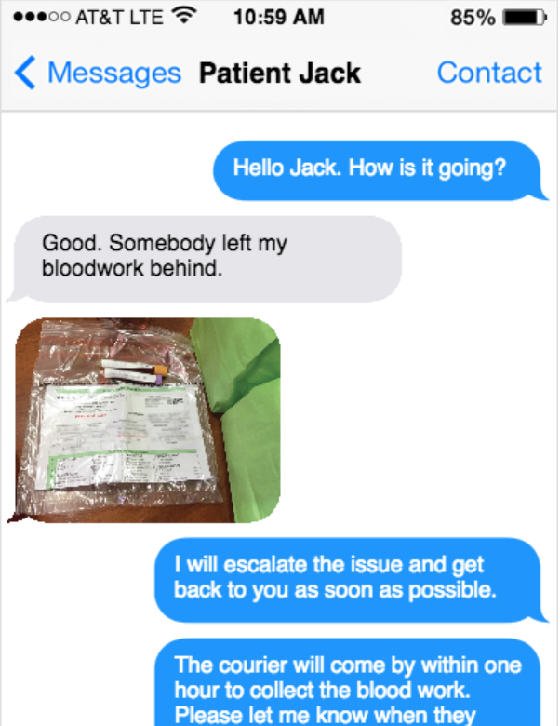
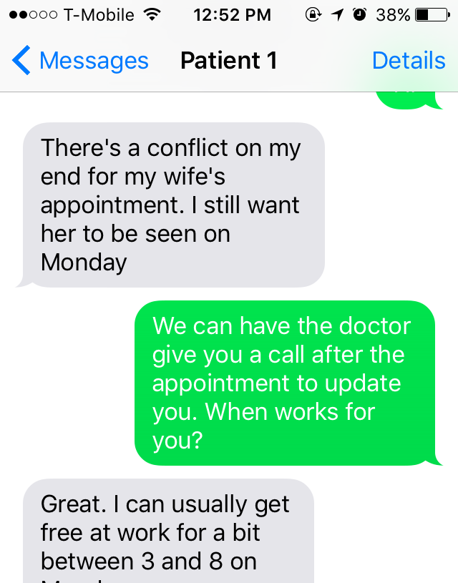
  Concierge
  Navigate users through an experience
Notes:
So what does that really mean? To give you an example, Mike Begley in Philadelphia worked with a team focused on reducing readmissions for patients discharged on outpatient antibiotic therapy. The team saw that 29% of patients who were discharged on outpatient antibiotics were readmitted within 30 days.
The team had a number of assumptions about the kind of support patients needed. Before going into solution mode, the team employed the concierge method to test those assumptions.
They set up a dedicated phone line for patients to text or call whenever they had questions or needs. The team also periodically checked in with patients to see how things were going. For a few weeks, the team did whatever they could, including a lot of things that weren't scalable, to answer questions, resolve issues, and so on. In doing so, they embedded themselves in the post-discharge patient experience.
The team confirmed some of their assumptions about what patients needed, but also uncovered some surprises. For example, one patient said he wasn't planning to attend his follow-up appointment because he didn't recognize the physician's name, nor did he know why it was scheduled in the first place. In fact, a number of patients were confused about the basic details of their care. This insight led the team in some unexpected directions.
I want to emphasize that learning doesn’t have to be passive! Sometimes you can learn the most by putting something out into the world, even if it’s something that won’t ever scale or be implemented.

Slide 29

  Concierge
  Navigate users through an experience
Notes:
Returning again to the infant mortality problem, the Stanford team decided to spend time with families, helping them through the process of caring for a premature or low-birth-weight infant. This gave the team a rich understanding of how these infants were cared for outside the hospital.

Slide 30
Increase access to incubators
Incubators are rare
Most Nepalese infants are born at home
Most Nepalese infants never make it to hospital
Culture
Expensive
Donated Incubators
Distance to hospital
Cost
Newborns stay with mom
Education Level
Transportation
Confusing to operate
Difficult to repair
Notes:
During this concierge experience they discovered many cultural norms, including that newborn babies are not separated from their mothers and that most of these infants would never make it to a hospital.

Slide 31
The first question to ask is,
“What’s good about that?”
How will we know we solved the right problem?
How can we measure success?
Notes:
Now that we have conducted our research, the first question we should ask is ‘what’s good about that … This technique also helps ensure we remove any embedded solutions and focus on the problem and the value of our intended action

Slide 32
What’s good about
“increasing access to incubators?”
More babies will be able to reap the benefits of incubators
What’s good about that?
Well, incubators get babies to a safe temperature quickly and maintain it
What’s good about that?
More babies will survive
Notes:
Let’s take the incubator story.
As you can see, as it progresses, it gets to a more philosophical point or obviously this is the right thing to do. The goal is to move up to where you get to a meaningful metric but also one that is actionable. This question aims to pull out helpful criteria of a solution. This is a bit of an art.

Slide 33
Get babies to a safe temperature quickly and maintain it
Incubators are rare
Most Nepalese infants are born at home
Most Nepalese infants never make it to hospital
Culture
Expensive
Donated Incubators
Distance to hospital
Cost
Newborns stay with mom
Education Level
Transportation
Confusing to operate
Difficult to repair
Notes:
As you can our needle shifted – we reframed the problem to be meaningful to solve …

Slide 34

?
Penn
Providers
Payers
Patients
Stakeholders care about vastly different things
Notes:
In this incubator example, it’s a metric that new moms care about, that providers care about, and that government health agencies who were funding the work care about. However, if this scenario were in the US and we were considering payors, we would have to think about their perspective – would they want to cover 1000’s of these warming sacks when this benefit did not exist before? Would we need a metric on how, by reducing complications, we reduce the total cost of care? Or that by covering this benefit, payors could better market their insurance products to Employers?
You’re turn! Starting with your goal for your overall project that you shared earlier., e.g., increase CRC screening to x% or improve management of symptoms in oncology. Now we’re going to take next 20 minutes to work as teams to apply some of these methods we just learned … As a reminder

Slide 35

“Discover” the Problem Action Plan
  Where do opportunities exist to learn more about the problem?
Notes:
We will use this to help us determine our next steps, such as identifying where opportunities exist to learn more about the problem drivers.
Now we will break

Slide 36
Boot Camp Overview / Activities
Introduction + Ice Breaker
Needle + Problem Driver
Solution + Assumption
Action + Next Steps
Notes:
9:30 – take 10 minute break

Slide 37
Innovation Framework
Solution Definition
Problem Definition
Discover
Define
Define
Ideate
Measurable
Outcome /
Needle
Interest

Slide 38

Notes:
Diverge so you don’t use the wrong tool for the job. Value of generating multiple ideas.

Slide 39
The secret to tricking your brain to imagine new solutions…

Slide 40
The secret to tricking your brain to imagine new solutions…
…analogies and constraints
Notes:
Analogies – looking how industries solve problems similarly – to help think own limitations
Constraints – don’t boil the ocean, solve within context within environment and people

Slide 41
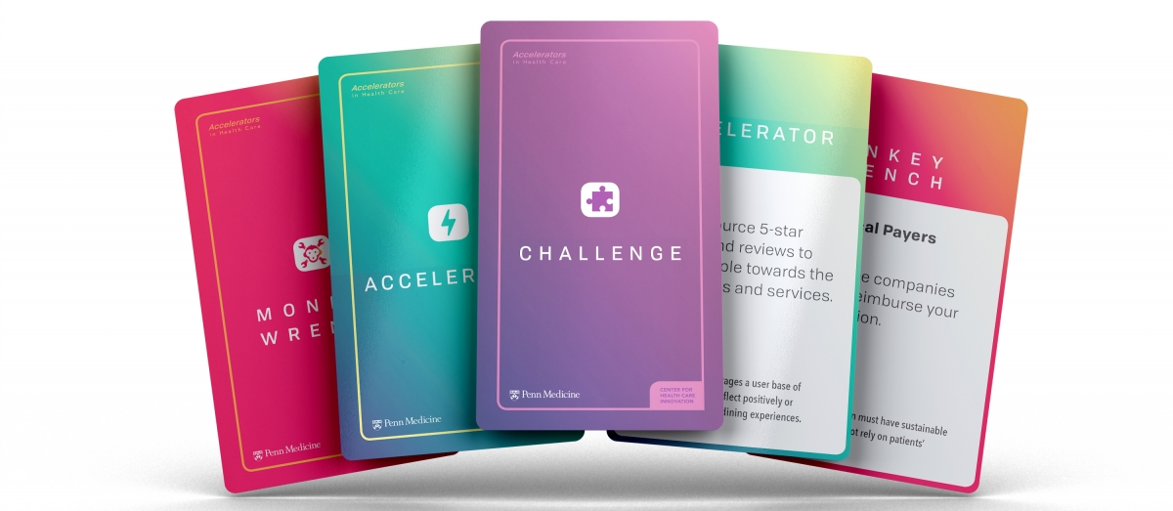

Slide 42
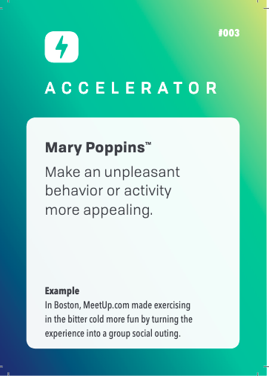
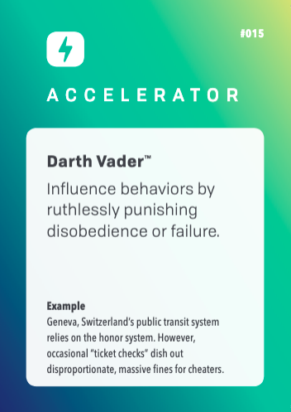
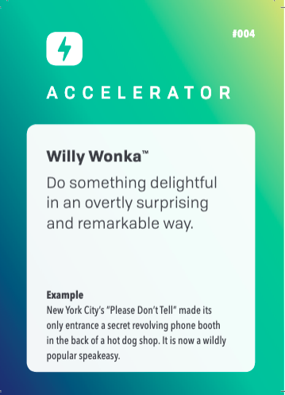
Notes:
Example analogies – pick 1 and talk through example -

Slide 43
How might we __increase medication adherence__ when __patients are confused by their medications__ ?
Notes:
We’re going to generate ideas around problem statement…. E.g., ..

Slide 44
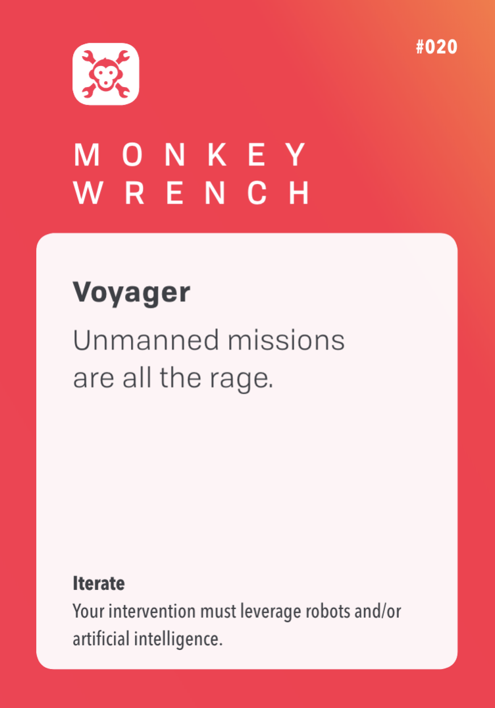
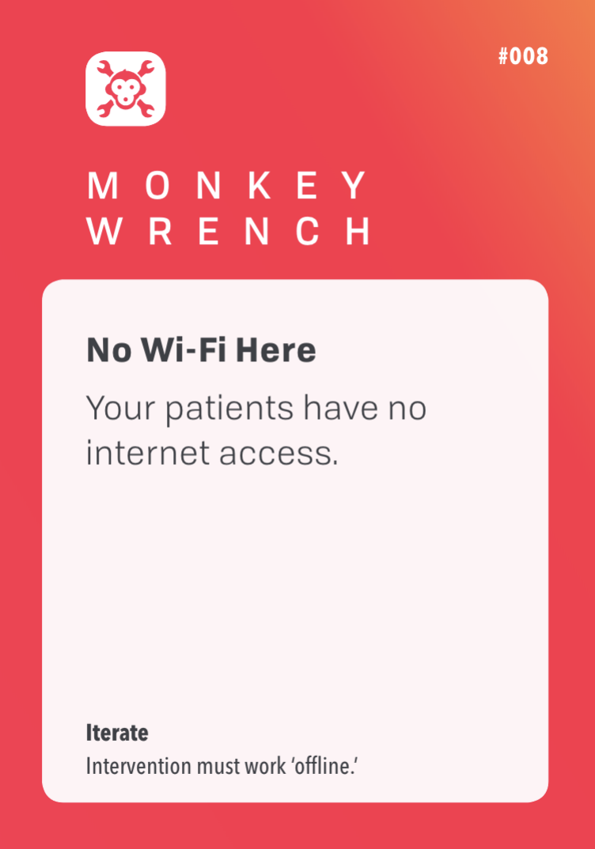
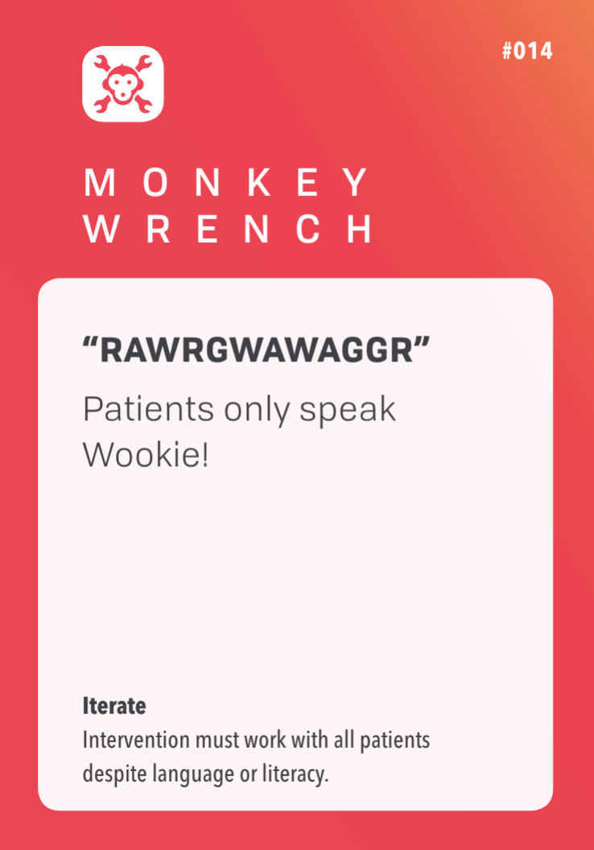
Notes:
Constraints and limitations.., e.g.,
Do worksheet and game here….

Slide 45
We believe if __pre-pack daily medications __ then __we will increase medication adherence__ .

Slide 46
Innovation Framework
Problem Definition
Solution Definition
Discover
Define
Ideate
Validate
Measurable
Outcome
Interest
Impact
Notes:
What do we do next … testing our assumptions – value of that …
10:10

Slide 47


Don’t build
that won’t work, fool!

Slide 48
Risky Assumptions:
What must be true for this
to work?

Slide 49
What is an assumption?
An assumption is something that must be true for your solution to work.
Testing assumptions can help you de-risk solutions before you invest too many resources.
Desirability
Do people want it?
Is it technically and operationally feasible?
Feasibility
Viability
Is it financially viable?

Slide 50
Devastating
If not true
Certain
Likelihood to be true
Uncertain
No big deal

Slide 51
Patients will ACTUALLY be more adherent
Insurance companies will cover the cost of the boxes
Devastating
if you’re wrong
I Am Sure
this is true
Likelihood to be true
No Idea
if this is true
We can get the pill boxes to the patients in time
Local Pharmacies are willing to fill the pill boxes
No big deal
if you’re wrong

Slide 52
Devastating
We can get the pill boxes to the patients in time
Patients will ACTUALLY be more adherent
If not true
Certain
Likelihood to be true
Uncertain
Local Pharmacies are willing to fill the pill boxes
Insurance companies will cover the cost of the boxes
No big deal

Slide 53

Design an experiment

Slide 54
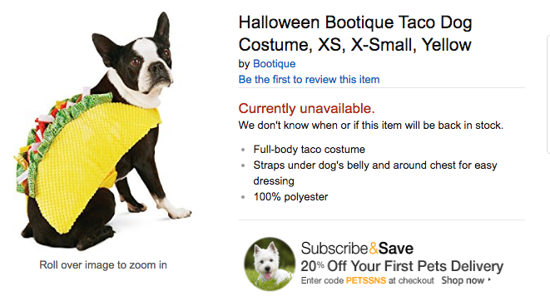
Vapor Test
Do people want it?

Slide 55
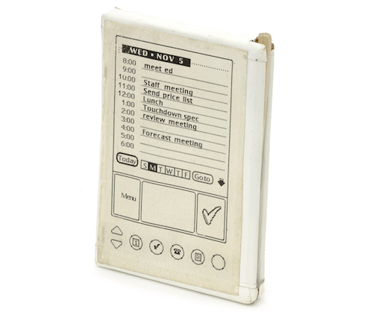
Fake
Front End
How will they use it?

Slide 56
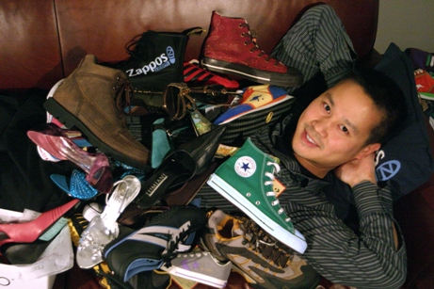
Fake
Back End
Will they use it and will it move the needle?

Slide 57
We believe if we __send patients home with a first weeks supply of pre- packed meds__ then __patients will actually be more adherent__ .

Slide 58
Boot Camp Overview / Activities
Introduction + Ice Breaker
Needle + Problem Driver
Solution + Assumption
Action + Next Steps
Notes:
10:45am

Slide 59
Before next meeting
  Review portal and begin stakeholder map
  Opportunities for project team to learn more about current state
  Opportunities to learn more about the problem
  Discuss next steps and where to go from here

Slide 60


